Slide 1
NYC Taxi Data Exercise Modeling Airport Pickups and Drop-offs
June 1 2018
Dan Finkel
Dan.Finkel@gmail.com
617.640.9968
https://www.github.com/danfinkel/

Slide 2
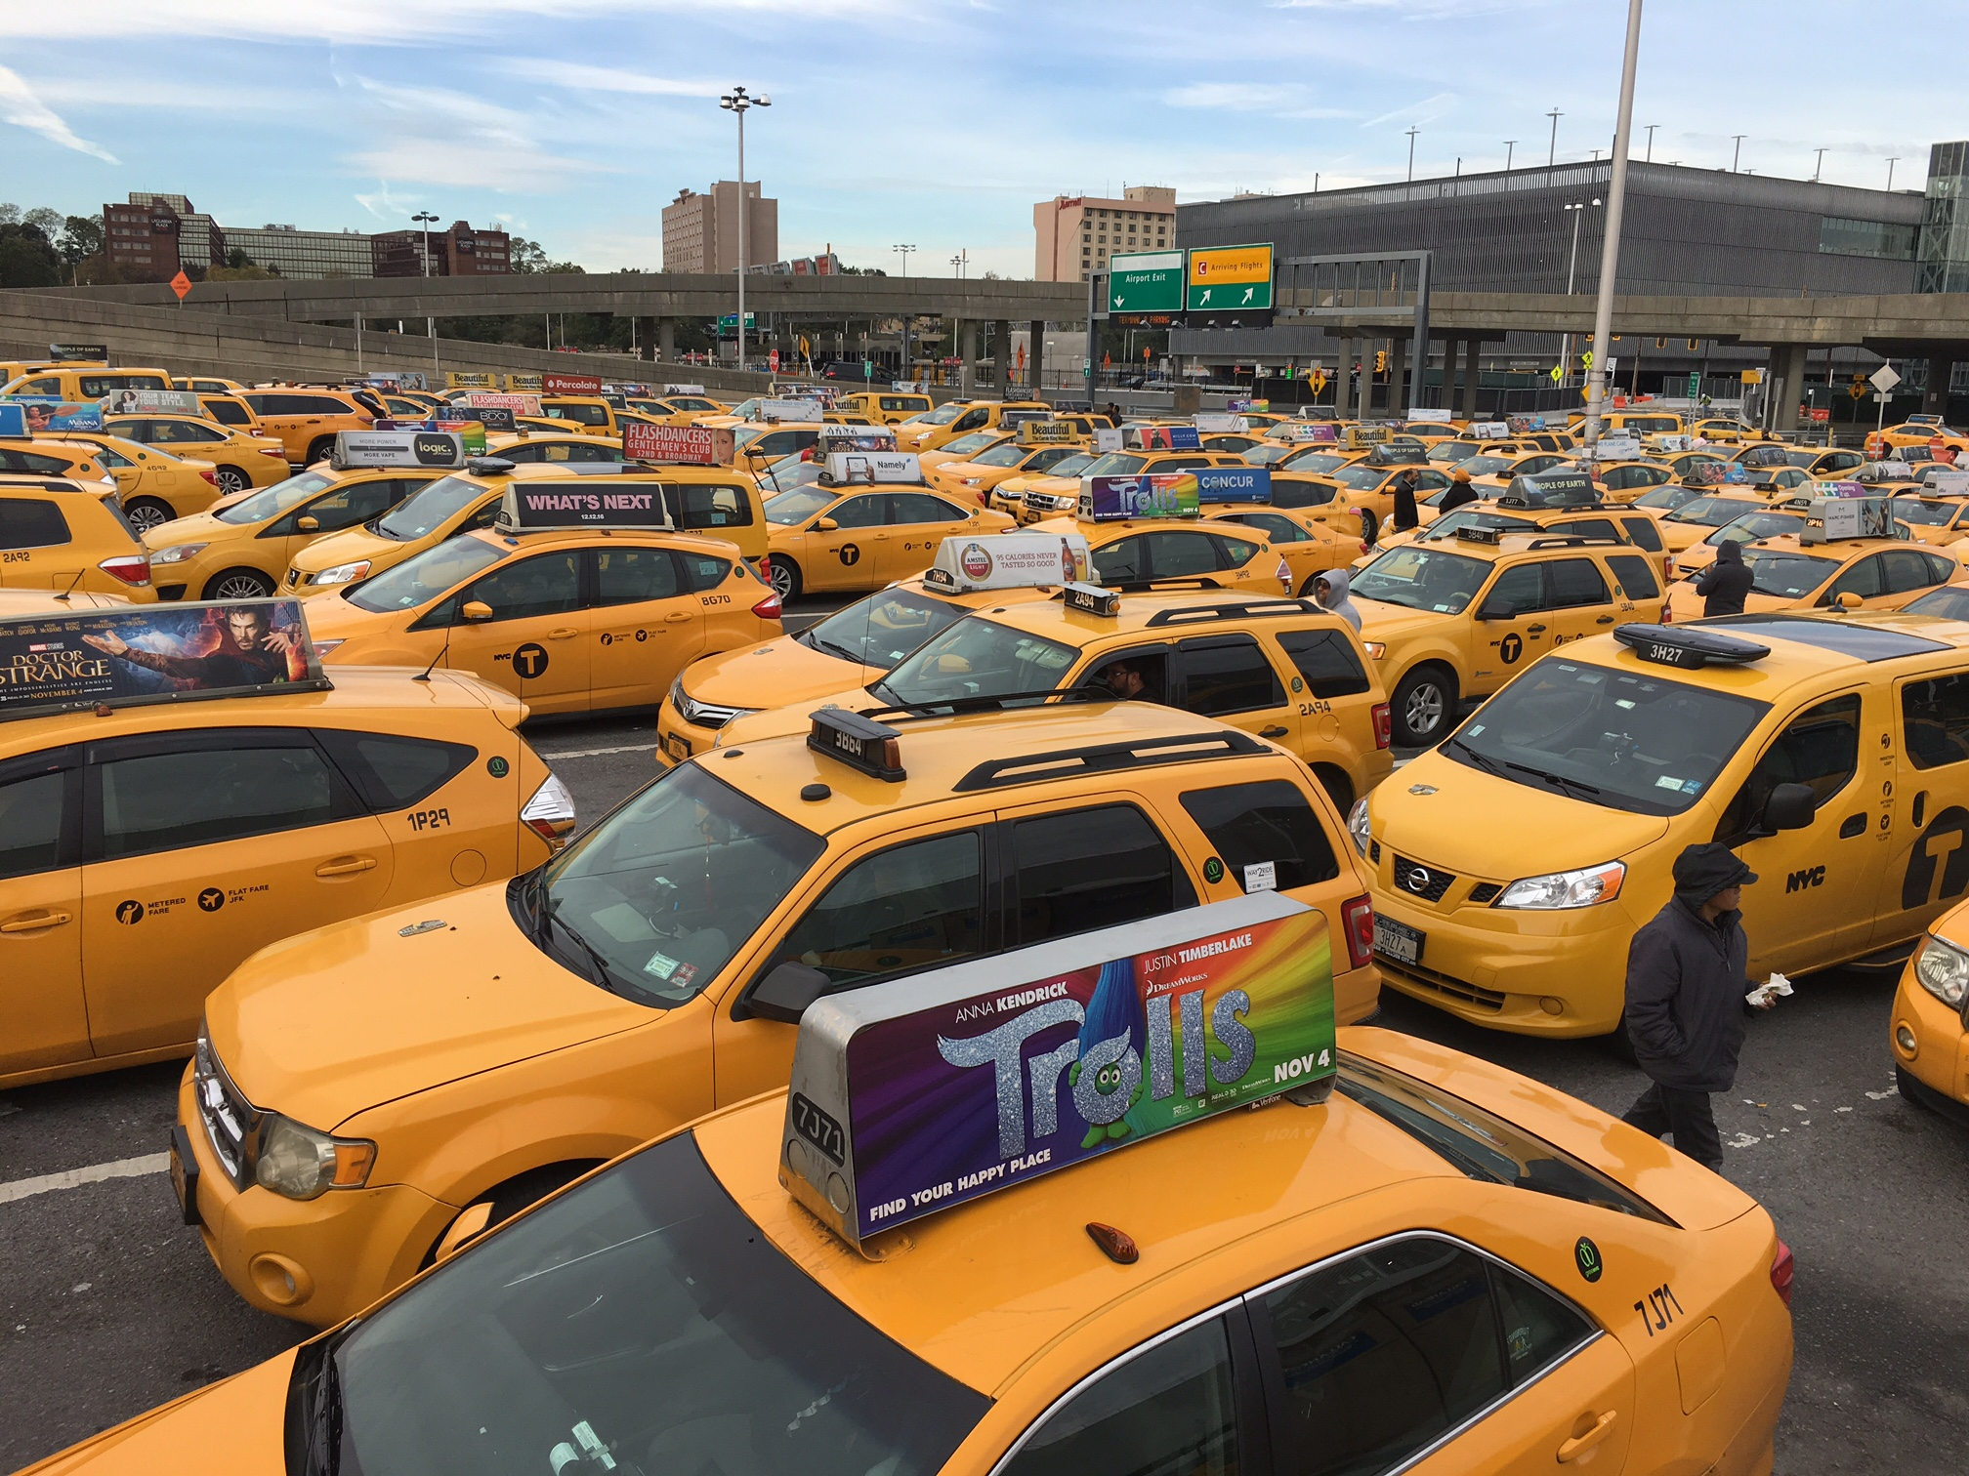
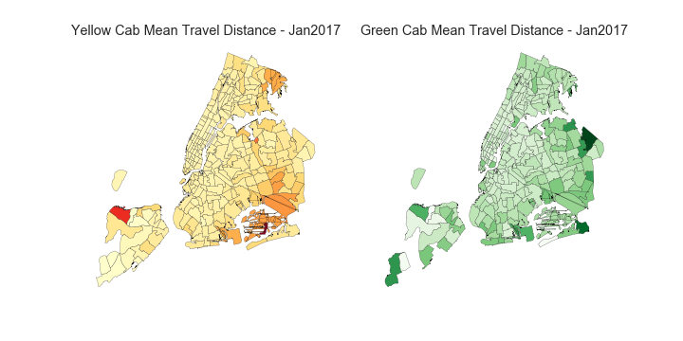
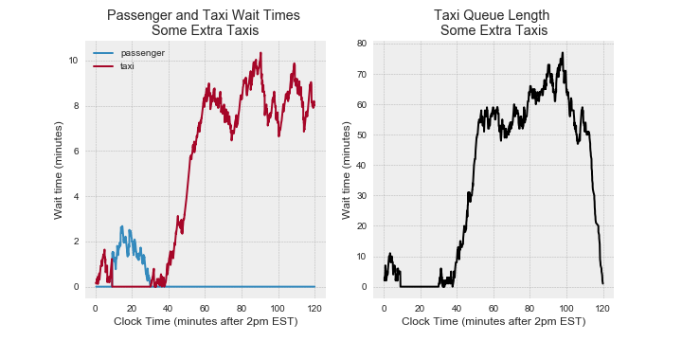
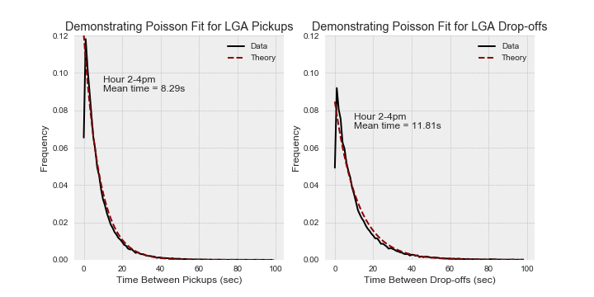
Executive Summary
Problem
Dataset
Data Exploration
Geospatial taxi behaviors well captured in public NYC-provided datasets
Datasets highlight similarities and differences in green and yellow taxi behavior
Airport Taxi Queue Analysis
Airport taxi arrivals and departures fit traditional Poisson-based queuing models
Modeling can be used to characterize idle times, manage parking space and improve customer wait times
Next Steps
Additional information about taxi trip (e.g., car ID, coordinate info) can improve model assumptions
Additional model complexity can be added to address more challenging questions and airport routing schemes
Product
Model

Slide 3
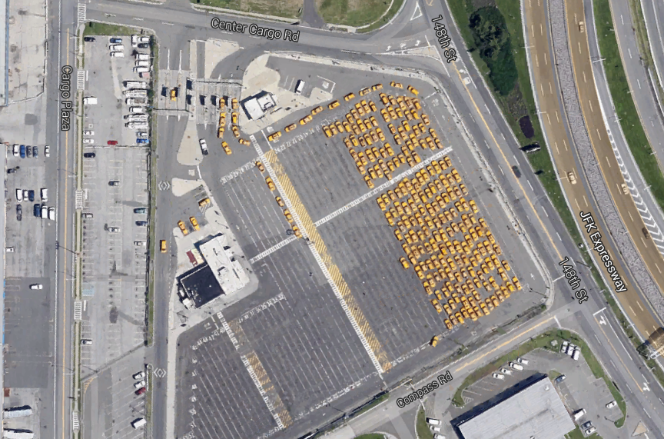
Problem Description
Questions (Policy-Motivated)
How is taxi queuing management aligned with customer demand?
Are there opportunities to improve efficiency?
Analytic Approach
Utilize NYC taxi data (Jan – Mar 2017)
Develop simple queuing model and validate with data
Utilize Monte Carlo simulations to characterize queue behaviors for different parameter settings
“The impact of ride-booking services on the taxi industry has been well-documented, but it is the demand for parking that may be of most concern for airport officials since it is one of the airports’ biggest moneymakers.” – Sept 25 2017 (url in notes)
Taxi Parking Lot at LaGuardia Airport NYC
-
Notes:
https://www.washingtonpost.com/local/trafficandcommuting/the-popularity-of-uber-lyft-boosts-airport-revenue-but-there-are-trade-offs/2017/09/25/5144b198-9efc-11e7-8ea1-ed975285475e_story.html?noredirect=on&utm_term=.718283f41f6e

Slide 4
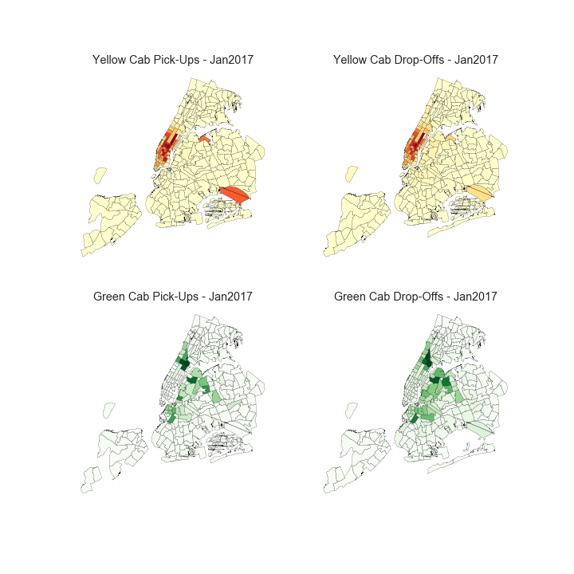
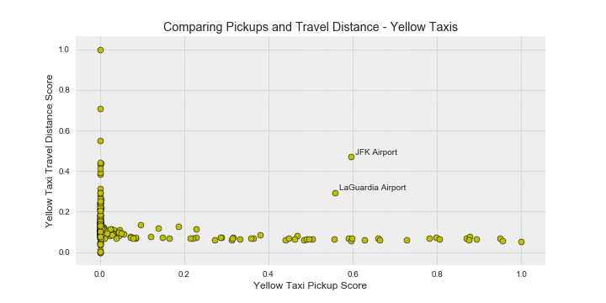
Data Overview
Data Provider:
Popular NYC Taxi Drop-off and Pick-up Locations (Jan 2017)
Comparing NYC Taxi Zones by Volume and Mean Trip Duration
Long
Some taxi zones produce long trips but little traffic
Taxi Zone
Airports are unique outliers
Trip Duration
Most zones yield low traffic and short duration trips
Some taxi zones are very busy but the trips are short
Yellow cabs
Yellow cabs
Pickups
Dropoffs
Green cabs
Green cabs
Short
Low
Pickup Rate
High
NYC Airports are Unique Locations for Taxi Traffic

Slide 5
Model Overview
Simple Queuing Model
Comparing Open Source Data to Theoretical Models
Time Between Airport Pickups
Time Between Airport Drop-offs
…
Assumptions
LGA has a single queue for taxis
All taxis who drop-off enter queue for passenger pickups
Taxis and passengers arrive via Poisson Process
Taxis are assigned to passengers instantly (e.g., via phone-app)
Queue models assignment process, i.e., actual queue is virtual (e.g., Uber)
…
Taxi Customer Pickups and Drop-offs Strongly Fit* a Poisson Counting Process Model
* Model parameters vary over the course of the day and model assumptions degrade during early am hours

Slide 6
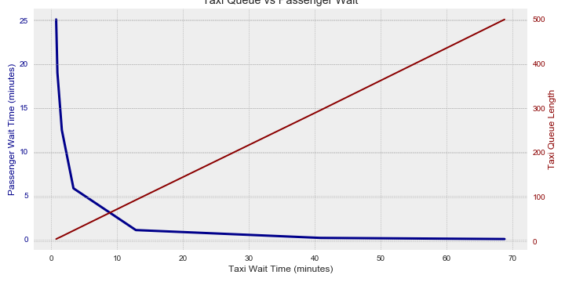
Results and Next Steps PRELIMINARY
Key Takeaways
Current taxi lot size is too big and may lead to large taxi queues
Lot could be shrunk to reduce idle taxis and reallocate space
Results are preliminary and additional fidelity is needed to gain confidence in results
Simulation Results – How Much Queue Space is Needed for Taxis?
25
500
Approx 400 spaces in LGA taxi lot
Full lot drastically exceeds passenger demand
Long wait times for drivers
Many idle taxis
20
400
15
300
Taxi Queue Length (Cars)
Passenger Wait Time (minutes)
Next Steps
10
If Taxi Lot Capacity was Halved…
Passengers would see small increase in wait time
Drivers would reduce wait time by almost 50%
200
Increase complexity of model to gain confidence in results
Define app-based taxi-passenger assignment
Add key information to data requests
Break airport into terminals
Label each taxi ride with car and/or driver ID
5
100
0
0
0
10
20
30
40
50
60
70
Average Taxi Wait Time for Passenger (minutes)
Notes:
Add lag times, taxi drop-outs and assignment costs

